Slide 1
2019 Autumn Realtime Graphics
Digital 2D Image Basic
Masaki Hayashi

Slide 2
2D Image Digitization

Slide 3
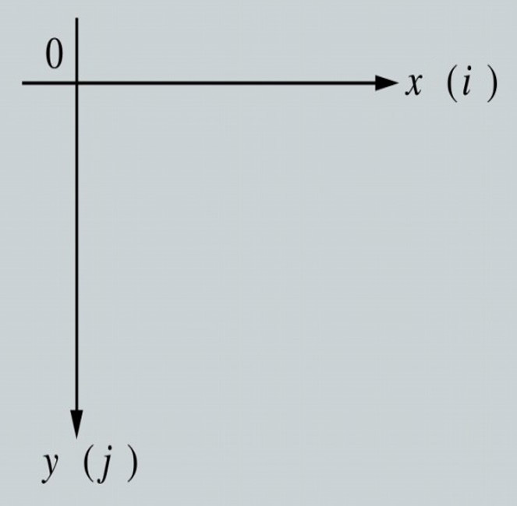
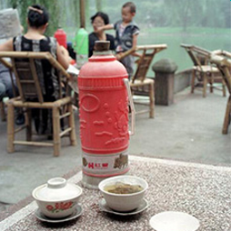
2D coordinate in imaging system
Mathematics
y
0
x

Slide 4
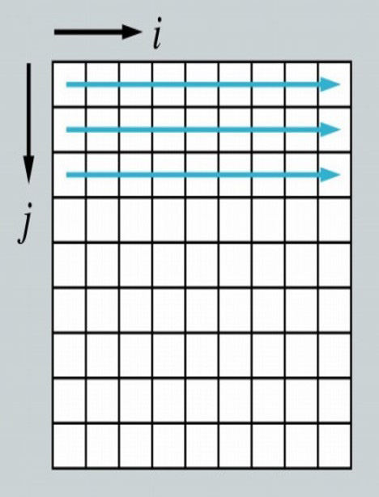
Scanning

Slide 5
Image data
> 2 dimensional data
125
5
185
225
12
127
115
114
135
3
0
95
45
62
235
245
244
25
.......
1
92
35
9
121
3
15
165
121
.......
> series of data
125 5 185 225 12 127 115 114 135 .... 3 0 95 45 ....

Slide 6
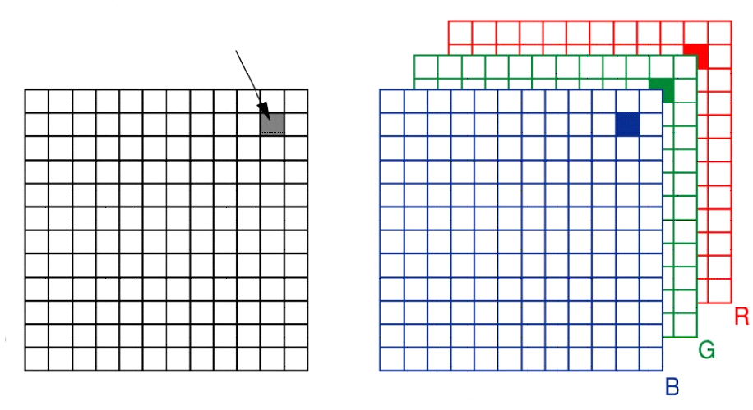
Gray scale & RGB
pixel
Grey scale (Black & white)
RGB (Color)

Slide 7
Image size
Spatial
pixel
Size (Resolution)
320 x 240
640 x 480 → SDTV
1920 x 1080 → HDTV
3840 x 2160 → 4K
4096 x 2160 → 4K (cinema)
7680 x 4320 → 8K
......
V size
H size
( TV industry )

Slide 8
Image depth
pixel
Depth (sampling bit rate)
1 pixel has:
8-bit
V size
10-bit
12-bit
14-bit
16-bit,...
Depth
H size

Slide 9
Image depth
Number of level
8-bit has 256 levels
2 x 2 x 2 x 2 x 2 x 2 x 2 x 2 = 2⁸ = 256
10-bit (1024 levels)
12-bit (4096 levels)
16-bit (65536 levels)
One level difference of 256 levels
is actually visible....
( 8-bit = 1 byte )
Depth and Color
24-bit RGB
||
8-bit X 3
||
256 x 256 x 256
= 1.677 million colors
32-bit color usually has RGBα
it is equivalent to 24-bit color
e.g.
iMac 4K/5K has 10-bit depth
which is 30-bit RGB

Slide 10
Features of image (summary)
Resolution
Depth
Sharpness
Spatial detail
Color representation
Dynamic range
Picture quality degradation when processed

Slide 11
Aspect ratio
512
Square pixel, basically
3456
1 : 1
640
512
3 : 2
(Film)
2304
4 : 3
(TV in the past)
480
1920
16 : 9
(HDTV, 4K, 8K)
1080
? : ?
(Computer, cinema, etc.)

Slide 12
Color system

Slide 13
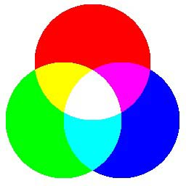
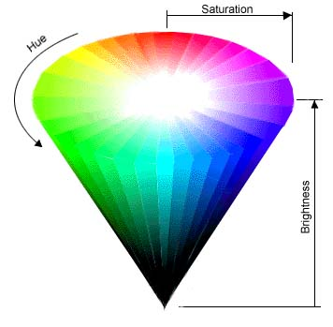
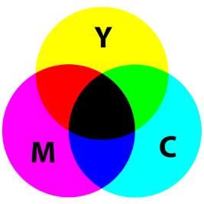
Color scheme
R (Red)
H (Hue)
G (Green)
S (Saturation)
B (Blue)
B (Brightness)
Additive color mixing

Slide 14
Color scheme
RGB
Brightness
+
Chroma
Brightness
Hue
+
Saturation
Brightness:
Y = 0.3R + 0.59G + 0.11B
(Luminance)
CR = R - Y
Chroma:
CB = B - Y

Slide 15
Color scheme
Chroma Hue + Saturation
CB
CR
H
S
C_{R}
H = tan⁻¹ (CR/CB)
S
H
C_{B}
S = C_{R} ² + C_{B} ²

Slide 16
Color scheme
Y C_{B} C_{R}
Slightly different but almost same
Y PB PR
Y U V
Brightness
Color components
Imagine coloring
Human eye is less sensitive to color, compared to brightness.
You can reduce the data amount by using this characteristic.
4:4:4 RGB, baseband
4:2:2 YUV, half res for UV.
4:1:1 YUV, quarter res for UV.
....

Slide 17
Image compression

Slide 18
Image format
JPEG
Most popular
Mosquito noise, Blocky noise
Not suitable for Logo, text, cartoon
GIF
Popular in the past.
Motion-GIF is still used
Only 256 colors
PNG
Improved version of GIF, Most commonly used in the Internet
Un-limited color. OK for both natural image and logo stuff
Loss-less compression (no quality selection)

Slide 19


How JPEG compress image
INPUT
Image
8×8 spatial
8×8 frequency
Important
Less important
Split into 8×8 blocks
Discrete Cosine Transform
(DCT)
Quantization
& Entropy coding
Approx. 1/10 compress
8×8 blocky noise
Mosquito noise at sharp edge
JPEG data series
OUTPUT

Slide 20
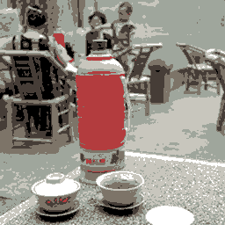
How GIF compress image
INPUT
16777216 colors
256 colors
Reduce colors
LZW compress
GIF data series
Good for logo, font, cartoon Bad for photograph
No blocky noise, no mosquito
Taken over by PNG
(similar to ZIP)
OUTPUT

Slide 21
How PNG compress image
INPUT
16777216 colors
Deflate compress
PNG data series
(similar to ZIP)
OUTPUT
Good for all kinds
Loss less
No blocky noise, no mosquito

Slide 22
Compression method of ZIP, etc.
LZW, Deflate,... etc.
INPUT
Output
0 0 0 0 0 0 0 0 3 3 3 3 3 3 3 3 3 3 3 3
0 x 8, 3 x 12
0 1 0 1 0 1 0 1 0 1 0 1 0 1 0 1 0 1 0 1
(01) x 10
compress
The more random the input data is, the less compression the output is.

Slide 23
Image processing

Slide 24
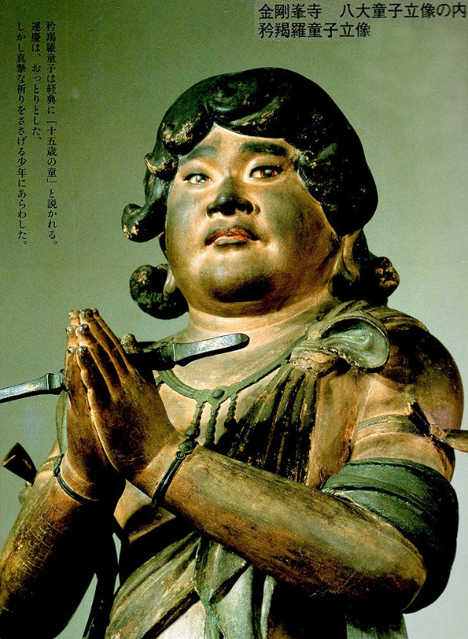
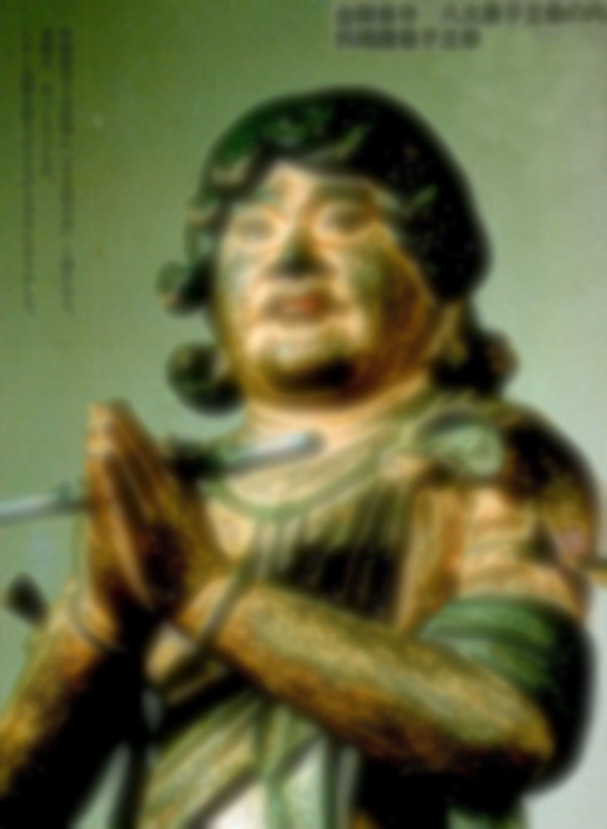
Spatial filtering

Slide 25
Spatial filtering
-1
-1
-1
-1
9
-1
50x(-1) + 50x(-1) + 150x(-1) + 100x(-1) + 100x9 + 100x(-1) + 120x(-1) + 120x(-1) + 120x(-1) = 90
-1
-1
-1
Filter
(3x3 kernel)
convolution
60
50
50
150
150
110
50
50
150
130
100
100
100
100
90
90
40
120
120
120
120
110
170
50
50
150
150
Input image
Output image
Move the frame 1 pixel to the right and repeat the same convolution

Slide 26
Spatial filtering
-1
-1
-1
-1
9
-1
50x(-1) + 50x(-1) + 150x(-1) + 100x(-1) + 100x9 + 100x(-1) + 120x(-1) + 120x(-1) + 120x(-1) = 90
-1
-1
-1
Filter
(3x3 kernel)
convolution
60
50
50
150
150
110
50
50
150
130
100
100
100
100
90
90
40
120
120
120
120
110
170
50
50
150
150
Input image
Output image
Move the frame 1 pixel to the right and repeat the same convolution

Slide 27
Smoothing
1/9
1/9
1/9
1/9
1/9
1/9
1/9
1/9
1/9
Mean filter

Slide 28
Edge detection
0
1
0
1
1
1
-1
2
-1
1
-4
1
1
-8
1
2
-4
2
0
1
0
1
1
1
-1
2
-1
Laplacian filter
Second spatial derivative of an image

Slide 29
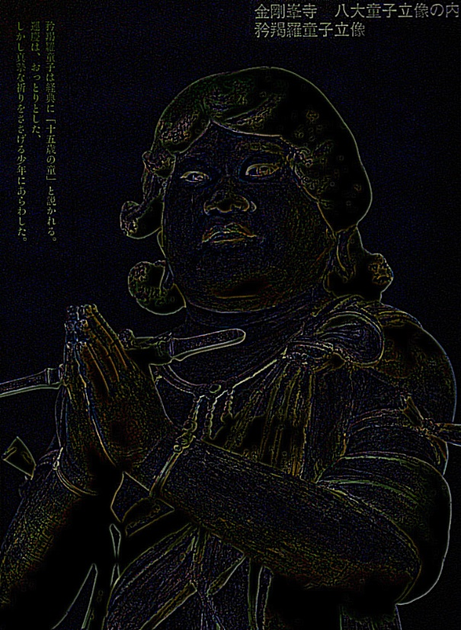
Edge detection

Slide 30
Edge detection
1
1
1 -2 1
0
0
0
0
0
1
1
1
-1
Laplacian filter

Slide 31
Edge enhancement (sharpen filter)
Edge enhancement using edge signal detected by laplacian
+
in
+
out
-
Laplacian
2.0
1 -2 1
1.0
1.0
1.0
0.0
0.0
-1.0
0.0
-1.0
0
-1
0
-1
4
-1
0
-1
0
Laplacian filter

Slide 32
Spatial domain vs Frequency domain
transforming
Frequency
signal
Spatial
signal
inverse-transforming
f
f

Slide 33
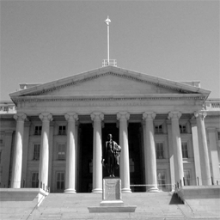
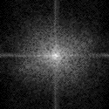
Spatial domain vs Frequency domain
Original image
Frequency signal
DFT
IDFT
Spatial domain
Frequency domain
DFT: Discrete Fourier Transform

Slide 34

Digital filter
DFT
Original image
Frequency signal
apply
Mask
= remove high frequency
Output image
Filtered signal
IDFT
Spatial domain
Frequency domain

Slide 35
Image magnification
Input
2 times magnification
Output
Gap
If output pixel position is calculated by using input pixel position

Slide 36
Interpolation
Input
2 times magnification
Output
Input pixel position should be calculated by output pixel position
Interpolated from the neighbored 4 pixel values

Slide 37
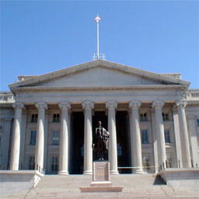
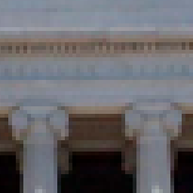
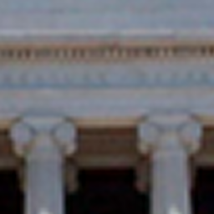
Image magnification
No interpolation
(Nearest neighbor)
Original image
With interpolation
(Bi-linear)
5 times zooming

Slide 38
Image shrinking
1/2 shrinking
Input
Output
This works but not enough
Aliasing problem

Slide 39
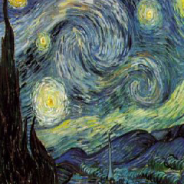
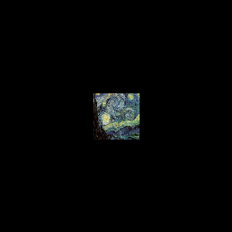
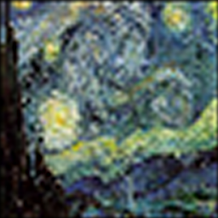
Image shrinking
Input
Output
5 times shrinking
Undesired signal called "aliasing" appears

Slide 40
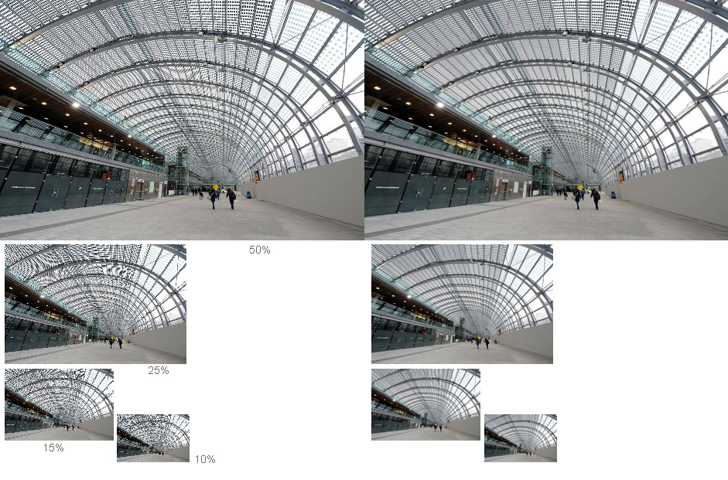
Aliasing noise
Bad...
Good

Slide 41
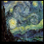
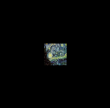
Mipmap
Original image

Slide 42
Sub-sampling & Anti-aliasing
Bad...
Aliasing
f
f / 2
f
f / 2
Good
LPF
No aliasing
f
f / 2
f
f / 2

Slide 43


Unti-aliasing
No Anti-aliasing
With anti-aliasing
(Low pass filtered prior to the shrinking)

